Slide 1
RAD.IO
A. Talha AYDIN - c1611006@student.cankaya.edu.tr
Omar DAYYA - c1611504@student.cankaya.edu.tr
Mehmet BİLGİÇ - c1611009@student.cankaya.edu.tr
Berkay KARADAYI - c1511034@student.cankaya.edu.tr
Advisor: Roya CHOUPANI
Co-Advisor: Nurdan SARAN

Slide 2
Contents
Problems
Pros and Cons to Similar projects / State of Art
Potential Risks and Expected Outputs
Infrastructure Diagram
Our RAD.IO
User Types
Sample UI Sketches
Platforms
Conclusion

Slide 3
Problems
Radios have to keep up with technology
Losing user’s interest
Lack of targeted recommendation (music/ads)
Lack of community and interactivity

Slide 4
Pros and cons to Similar Projects / State of Art
 | RAD-IO | RADYO Çankaya | RADYO-ILEF | RADYO ODTÜ | ETU-RADYO
Notifications / Push notifications | ✔️
Live Chat | ✔️ |  |  |  | ✔️
Live Stream | ✔️ | ✔️ | ✔️ | ✔️ | ✔️
Multiplatform | ✔️ |  | ✔️ | ✔️
Live survey | ✔️ |  |  |  | ✔️
Music Streaming Service Integrations | ✔️
User Data Analysis/ Feedback | ✔️

Slide 5
Potential Risks & Expected Solutions
Risks
High network traffic
Connectivity issues
Cross-platform incompatibilities
Solutions
By splitting the amount of user load by using load balancer.
By lowering the resolution and quality of the user automatically.
Some features might not work on other platforms, so we use wrapper functions.

Slide 6
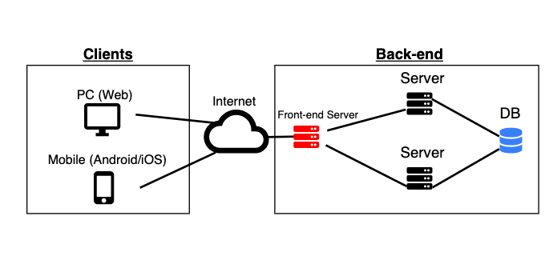
Infrastructure Diagram

Slide 7
Our RAD.IO
The purpose of the project is to develop a fast, interactive,and user-friendly online radio application that works on both web and mobile platforms.
Main Features:
Live Stream
Live Chat
Music Recommendation
Live Survey
Music Streaming Platform integrations (ex: Spotify)
(Optional) Event Recommendation
(Optional) Voice chat between User - Streamer

Slide 8
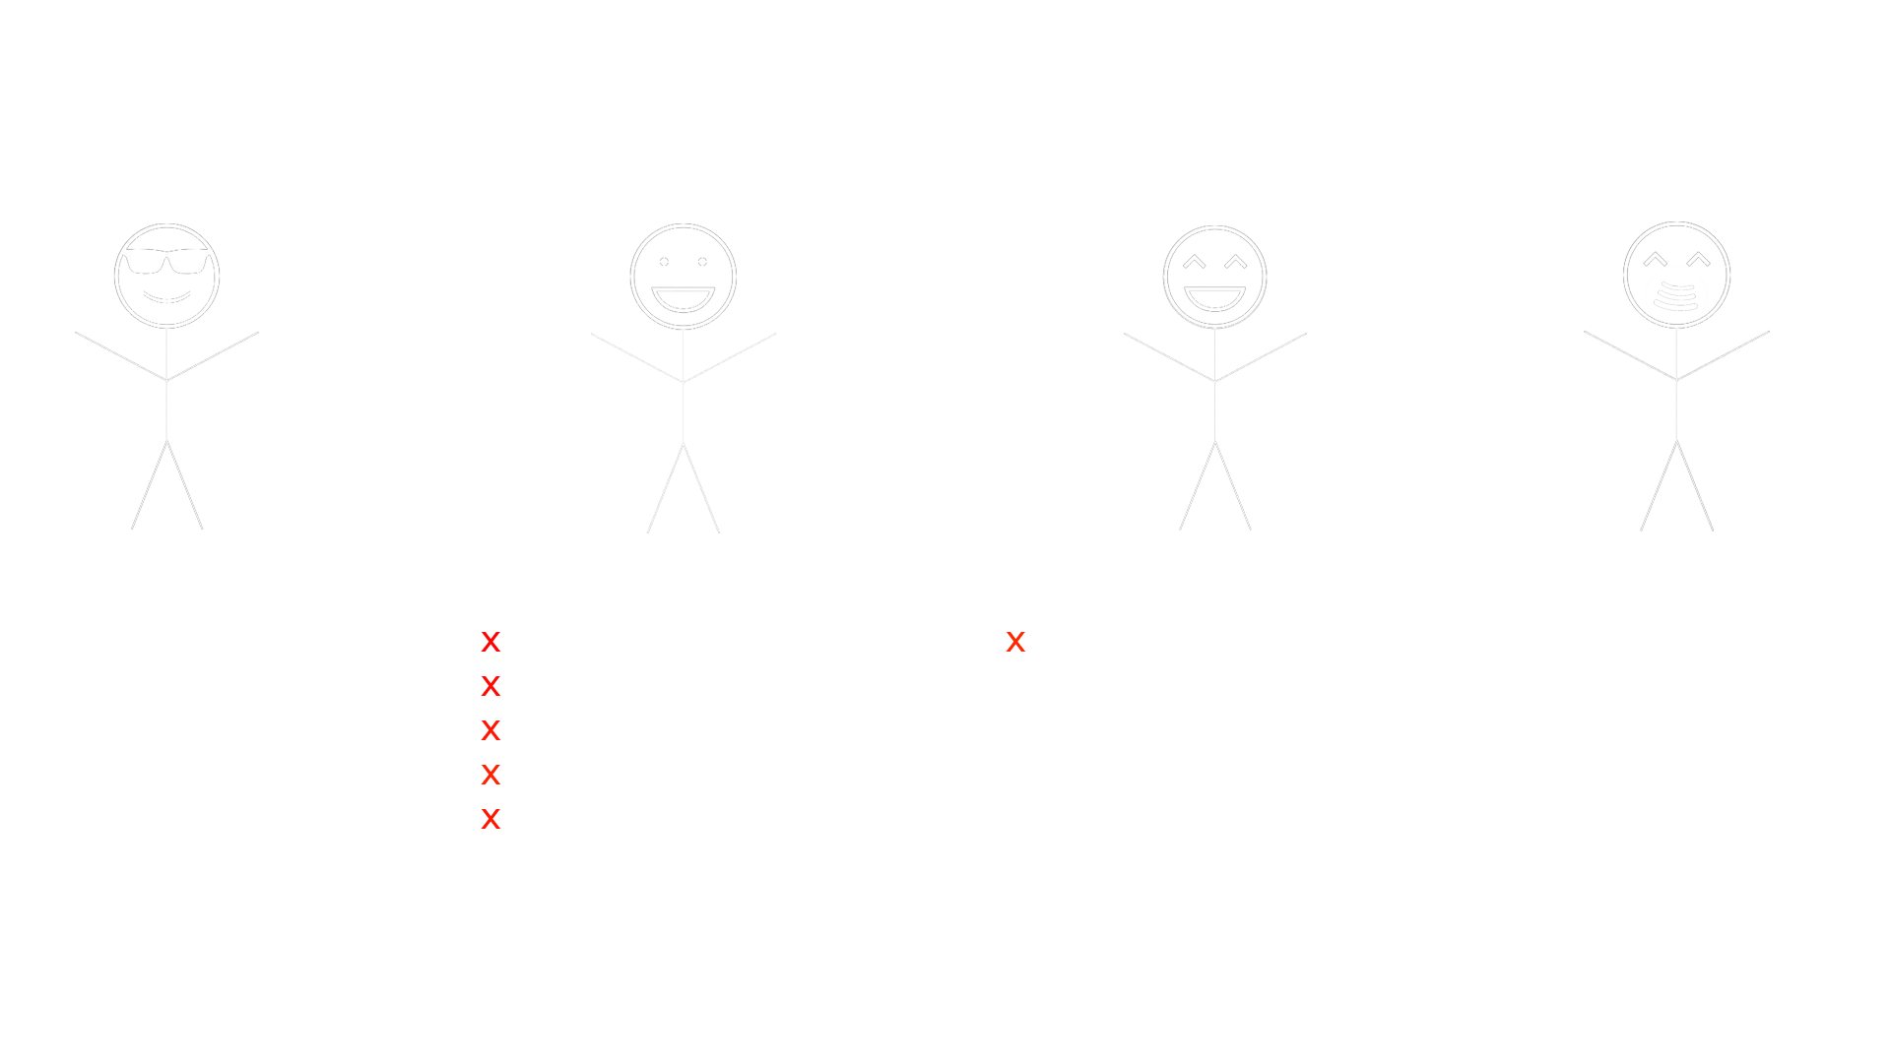

Slide 9
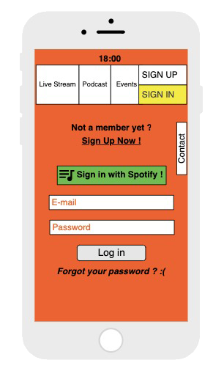
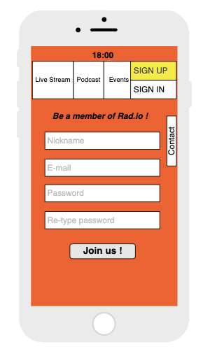
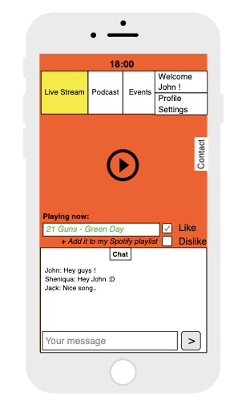
Sample UI Sketches

Slide 10
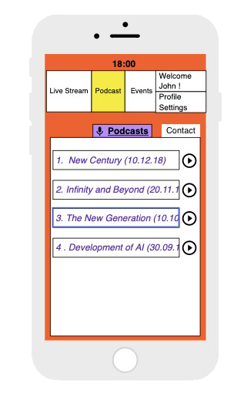
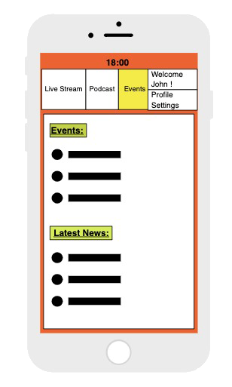
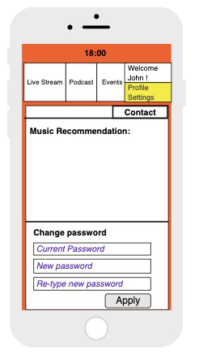
Sample UI Sketches

Slide 11
Platforms
Backend:
Python, Django
Mobile:
Flutter, Android Studio, Xcode
Frontend:
Bootstrap, Materialize CSS
Database:
PostgreSQL
Deployment:
Docker, Google Cloud, Nginx

Slide 12
Conclusion
Recall:
This project will be developed for both mobile and web platforms.
Main Features of application:
Live Stream
Live Chat
Live Survey
Music Integration
Having an innovative infrastructure for an internet radio might be advantageous for us in the radio sector. For using this advantage as a chance, we are developing a internet radio with a different point of view. At the end of the day, main components from the analog radio, innovative ideas from computer and multimedia technologies will lead our project.

Slide 13
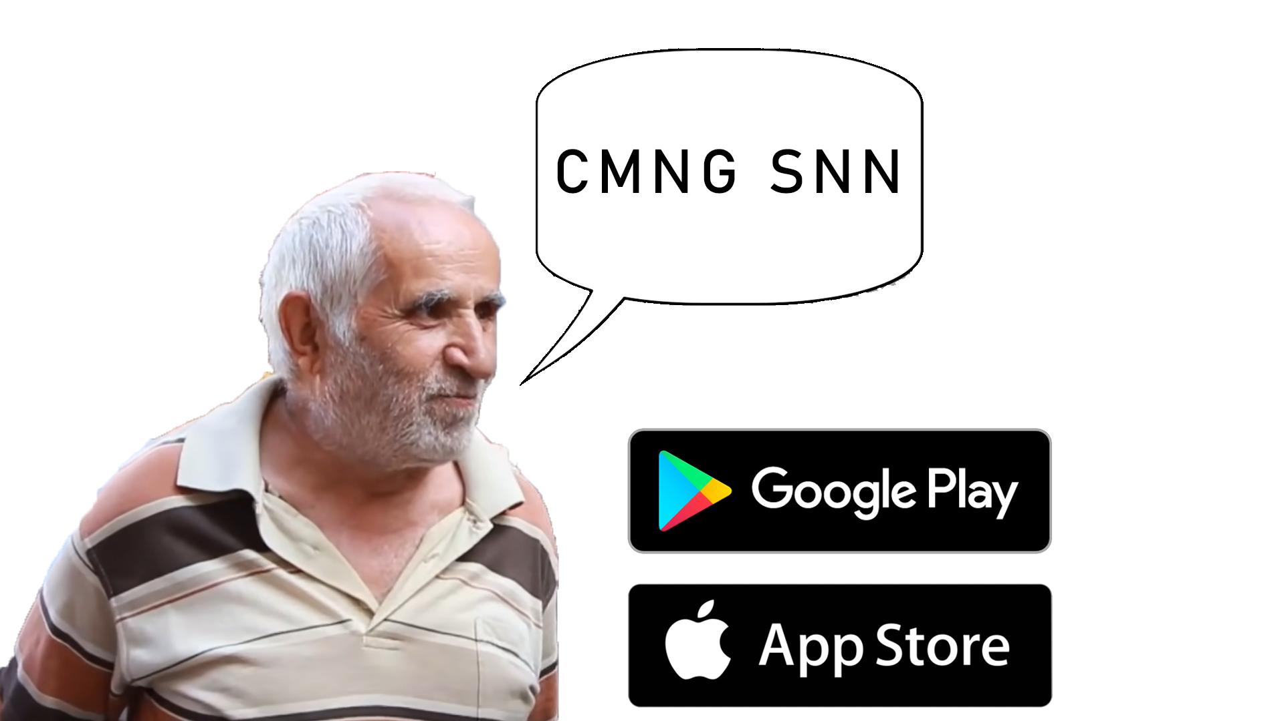


Slide 14




COMING SOON

Slide 15
Thank You
Any suggestions ?

